Slide 1
Animation
SEI

Slide 2
Enrichment: Animation
SEI

Slide 3
Three Types of Animation
We’re going to cover three animation techniques in this lesson:
Simple: transition property with the :hover pseudo-class.
Changes the background color of a button when the user hovers over it.
Less Simple: animation property with the @keyframes rule.
Moves an element on the page with animation.
JavaScript: Switch application state with .classList.toggle().
Triggers an off-canvas menu to appear or disappear.

Slide 4
Simple Animation
The easiest way to animate something in CSS is by using the transition property in conjunction with the :hover pseudo-class. This method includes:
The CSS property to be animated.
The time duration of the animation.
The type of animation to be used.

Slide 5
Transition Tips
The transition property is assigned to the off (initial) state of your component.
Typically, you can leave out the specific thing changing and just use something like transition: 0.4s ease-in-out;. If you’re sure you only want one specific property to transition, however, it’s safest to be specific and leave it in.
Animating multiple properties at once can be a bit much for you and for users, so go easy with this stuff!

Slide 6
Transition Example
Start
End
>
.button {
background-color: red;
transition: background-color 0.4s ease-in-out;
}
.button:hover {
background-color: orange;
}
Notes:
TALKING POINTS:
Transitions can also occur on elements nested within the button as the element itself and are often used for overlays: https://codepen.io/jkeohan/pen/rgYddb
Another use case is an animated hamburger menu: https://codepen.io/jkeohan/pen/eaerJY

Slide 7
Hiding Content
Keep your HTML block turned off with CSS. There are four methods with which to hide elements in CSS, each with slightly different results.
Property | Takes Up Space | Can Be Clicked
display: none; | No | No
visibility: hidden; | Yes | No
opacity: 0; | Yes | Yes
background: rgba(0,0,0,0) | Yes | Yes
Notes:
Source: https://stackoverflow.com/questions/14731049/visibilityhidden-vs-displaynone-vs-opacity0/34529598#34529598
TEACHING TIPS:
You might want to show them the Stack Overflow source of this table as a lesson in researching different options for doing the same thing. You can read documentation but often you can google the question you have, find a SO, and read through it for sensible answers and upvotes.

Slide 8
Keyframes and Animation
SEI

Slide 9
Less Simple Animation
Complex animations require multiple steps. For these, you’ll need to use CSS animation and @keyframes together. This will allow components to move in more interesting ways than simply appearing and disappearing!
Here’s what it takes:
Outline animation steps and timing.
Set each movement instruction of a @keyframes step (usually a transform).
Use CSS animation properties and apply everything to the component’s initial state.

Slide 10
CSS @keyframes
@keyframes work like media queries — conditional-based instructions that happen at particular times. Notice that we’re giving this a custom name, mover.
@keyframes mover {
0% {
transform: translateX(0) translateY(0);
}
50% {
transform: translateX(300px) translateY(0);
}
100% {
transform: translateX(300px) translateY(300px);
}
}

Slide 11
CSS Animation
The property contains a bunch of settings, similar to how background works.
.box {
animation-name: mover;
animation-duration: 2s;
animation-timing-function: ease-in-out;
animation-direction: alternate;
animation-iteration-count: infinite;
}
OR
.box {
animation: mover 2s ease-in-out alternate infinite;
}
Notes:
TALKING POINTS:
You can either define each property individually or do it all in one shorthand statement. It can be tricky to remember the order of the properties in the shorthand version, but keep in mind that all of this knowledge is a short Google search away once you know the concept!

Slide 12
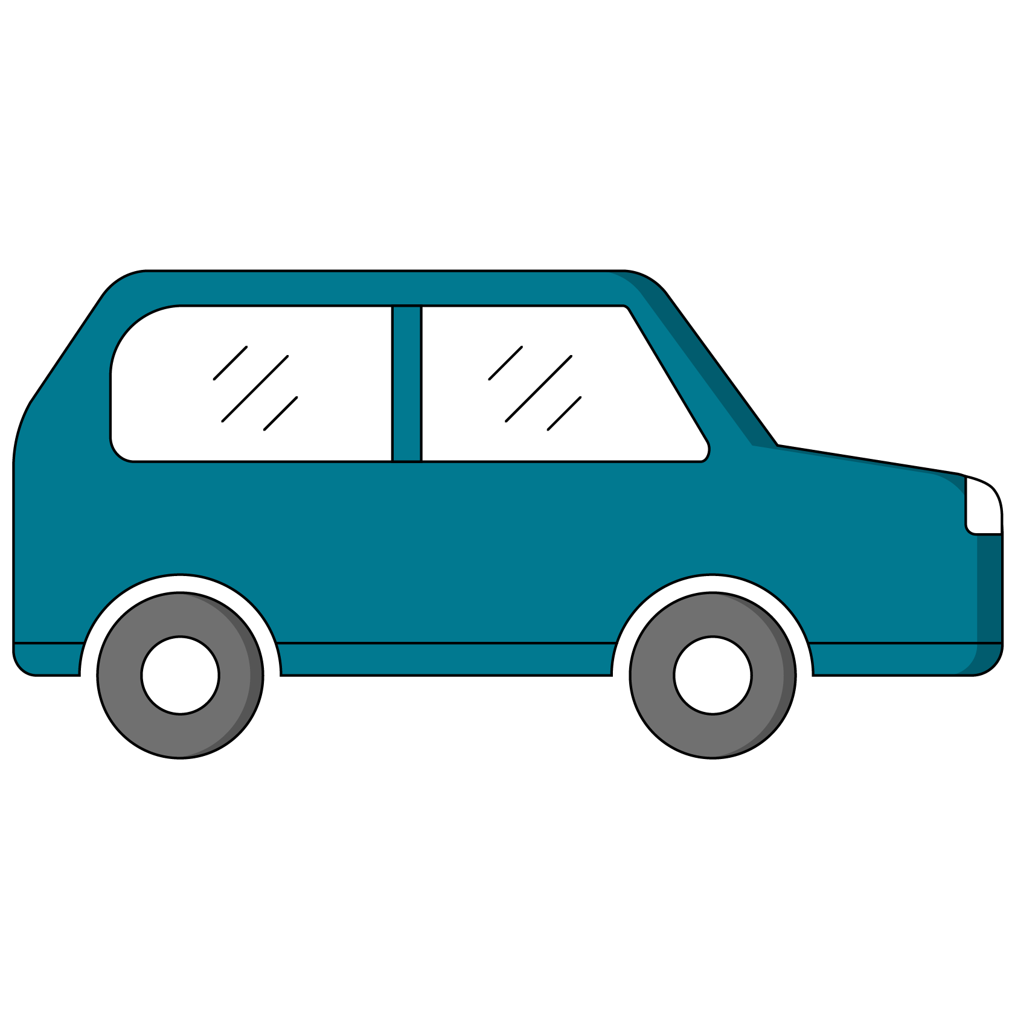
CSS Transforms
You can also adjust the shape and position of elements with transform. It’s not required to do animation, but it is the easiest way to move things fluidly.
You can do a lot with transform — CSS Tricks has great documentation, as usual!

Slide 13

Storyboard Keyframes
Complex animations require something akin to pseudocode before digging in.
Step 1 (0%):
Box top, left
Step 2 (50%):
Box top, right
Step 3 (100%):
Box bottom, right

Slide 14
Animations Practice
30 minutes
Practice applying these CSS properties in this CodePen.
14 | © 2020 General Assembly

Slide 15
Advanced Animation Resources
Charts.js: good enough charts/graphs
D3: a popular data visualization tool
GSAP: a keyframe animation toolkit

